Slide 1


Slide 2


雪梨華人基督教會
粵 語 堂 主 日 崇 拜
2020年7月26日上午九時十五分
請肅靜預備崇拜

Slide 3
默禱

Slide 4
宣召

Slide 5

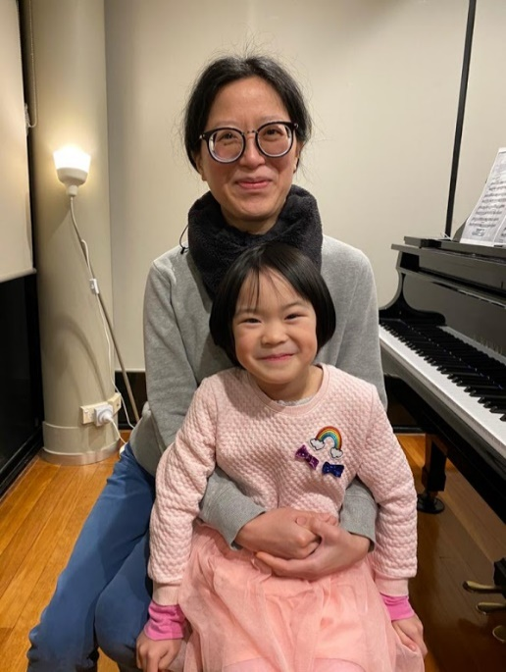
齊來讚美

Slide 6
和撒那，和撒那，
和撒那在那至高處。
和撒那，和撒那，
和撒那在那至高處。
Hosanna, hosanna,
hosanna in the highest
Hosanna, hosanna,
hosanna in the highest
和撒那 Hosanna
曲: Carl Tuttle 詞: 經文摘編~馬太福音21:9 《讚之歌3─和撒拿》© 中文譯作
財團法人基督教以琳書房版權所有
V1

Slide 7
主我高舉祢名，
心中充滿讚美。
齊來高舉我主我神，
和撒那在那至高處。
Lord we lift up Your name
With a heart full of praise
Be exalted, oh Lord my God
Hosanna in the highest
和撒那 Hosanna
曲: Carl Tuttle 詞: 經文摘編~馬太福音21:9 《讚之歌3─和撒拿》© 中文譯作
財團法人基督教以琳書房版權所有
C1

Slide 8
和撒那，和撒那，
和撒那在那至高處。
和撒那，和撒那，
和撒那在那至高處。
Hosanna, hosanna,
hosanna in the highest
Hosanna, hosanna,
hosanna in the highest
和撒那 Hosanna
曲: Carl Tuttle 詞: 經文摘編~馬太福音21:9 《讚之歌3─和撒拿》© 中文譯作
財團法人基督教以琳書房版權所有
V1

Slide 9
主我高舉祢名，
心中充滿讚美。
齊來高舉我主我神，
和撒那在那至高處。
Lord we lift up Your name
With a heart full of praise
Be exalted, oh Lord my God
Hosanna in the highest
和撒那 Hosanna
曲: Carl Tuttle 詞: 經文摘編~馬太福音21:9 《讚之歌3─和撒拿》© 中文譯作
財團法人基督教以琳書房版權所有
C1

Slide 10
榮耀，榮耀，
榮耀歸萬王之王。
榮耀，榮耀，
榮耀歸萬王之王。
Glory, glory,
glory to the King of kings
Glory, glory,
glory to the King of kings
和撒那 Hosanna
曲: Carl Tuttle 詞: 經文摘編~馬太福音21:9 《讚之歌3─和撒拿》© 中文譯作
財團法人基督教以琳書房版權所有
V2

Slide 11
主我高舉祢名，
心中充滿讚美。
齊來高舉我主我神，
願榮耀歸萬王之王。
Lord we lift up Your name
With a heart full of praise
Be exalted, oh Lord my God
Glory to the King of kings
和撒那 Hosanna
曲: Carl Tuttle 詞: 經文摘編~馬太福音21:9 《讚之歌3─和撒拿》© 中文譯作
財團法人基督教以琳書房版權所有
C2

Slide 12
榮耀，榮耀，
榮耀歸萬王之王。
榮耀，榮耀，
榮耀歸萬王之王。
Glory, glory,
glory to the King of kings
Glory, glory,
glory to the King of kings
和撒那 Hosanna
曲: Carl Tuttle 詞: 經文摘編~馬太福音21:9 《讚之歌3─和撒拿》© 中文譯作
財團法人基督教以琳書房版權所有
V2

Slide 13
主我高舉祢名，
心中充滿讚美。
齊來高舉我主我神，
願榮耀歸萬王之王。
Lord we lift up Your name
With a heart full of praise
Be exalted, oh Lord my God
Glory to the King of kings
和撒那 Hosanna
曲: Carl Tuttle 詞: 經文摘編~馬太福音21:9 《讚之歌3─和撒拿》© 中文譯作
財團法人基督教以琳書房版權所有
C2

Slide 14
主我高舉祢名，
心中充滿讚美。
齊來高舉我主我神，
願榮耀歸萬王之王。
Lord we lift up Your name
With a heart full of praise
Be exalted, oh Lord my God
Glory to the King of kings
和撒那 Hosanna
曲: Carl Tuttle 詞: 經文摘編~馬太福音21:9 《讚之歌3─和撒拿》© 中文譯作
財團法人基督教以琳書房版權所有
C2

Slide 15

齊來讚美

Slide 16
祢的信實廣大，我神我天父，
在祢永遠沒有轉動影兒；
永不改變，父神每天施憐憫，
無始無終上主，施恩不盡。
Great is Thy faithfulness, O God my Father
There is no shadow of turning with Thee
Thou changest not, Thy compassions they fail not
As Thou hast been Thou forever wilt be
祢的信實廣大 Great is Thy Faithfulness
Hymns of Life 生命聖詩 18 首
V1

Slide 17
祢的信實廣大，祢的信實廣大，
清晨復清晨，更經歷新恩；
我所需用，祢恩手豐富預備，
祢的信實廣大，顯在我身。
Great is Thy faithfulness! Great is Thy faithfulness!
Morning by morning new mercies I see
All I have needed Thy hand hath provided
Great is Thy faithfulness, Lord, unto me!
祢的信實廣大 Great is Thy Faithfulness
Hymns of Life 生命聖詩 18 首
C

Slide 18
春夏秋冬四季，有栽種收成，
日月星辰時刻運轉不停；
宇宙萬物都見證造物主宰，
述說天父豐盛，信實，慈愛。
Summer and winter, and springtime and harvest
Sun, moon, and stars in their courses above
Join with all nature in manifold witness
To Thy great faithfulness, mercy, and love
祢的信實廣大 Great is Thy Faithfulness
Hymns of Life 生命聖詩 18 首
V2

Slide 19
祢的信實廣大，祢的信實廣大，
清晨復清晨，更經歷新恩；
我所需用，祢恩手豐富預備，
祢的信實廣大，顯在我身。
Great is Thy faithfulness! Great is Thy faithfulness!
Morning by morning new mercies I see
All I have needed Thy hand hath provided
Great is Thy faithfulness, Lord, unto me!
祢的信實廣大 Great is Thy Faithfulness
Hymns of Life 生命聖詩 18 首
C

Slide 20
祢赦免我罪過，賜永遠安寧，
祢常與我同在，安慰引領；
求賜今天力量，明天的盼望，
從天降下恩典，福樂無窮。
Pardon for sin and a peace that endureth
Thy own dear presence to cheer and to guide
Strength for today and bright hope for tomorrow
Blessings all mine, with ten thousand beside
祢的信實廣大 Great is Thy Faithfulness
Hymns of Life 生命聖詩 18 首
V3

Slide 21
祢的信實廣大，祢的信實廣大，
清晨復清晨，更經歷新恩；
我所需用，祢恩手豐富預備，
祢的信實廣大，顯在我身。
Great is Thy faithfulness! Great is Thy faithfulness!
Morning by morning new mercies I see
All I have needed Thy hand hath provided
Great is Thy faithfulness, Lord, unto me!
祢的信實廣大 Great is Thy Faithfulness
Hymns of Life 生命聖詩 18 首
C

Slide 22

齊來讚美

Slide 23
請開我眼 打開我心
明白祢有多麼深愛我
請釋放我 去我纏累
能讓我再有力榮耀祢
Open my eyes. Open my heart,
so I’ll know, deep is Your love for me.
Release my pain and misery.
Give me strength to glorify Your name.
祢是我神 You are my God
曲﹑詞: 霍志鵬《敬拜者的心》© 香港學園傳道敬拜者使團版權所有
V1

Slide 24
祢為我釘身受死 抹去我的污穢
祢是我神 是我王 我心欣慰
我為祢張開我口 向世界高聲唱
竭力讚揚 願永傳祢大愛
You died for me on the cross, washed away my sins
for You are my God, You’re my king I am grateful.
I’ll praise Your name with my voice, praising You forever.
With every breath, I’ll sing of Your great love.
祢是我神 You are my God
曲﹑詞: 霍志鵬《敬拜者的心》© 香港學園傳道敬拜者使團版權所有
C1

Slide 25
請改變我 謙卑我心
明白我有多麼需要祢
心緊靠祢 進祢懷內
容讓我永貼近隨著祢
Bring change in me. Humble my heart,
so I’ll know how much I’m needing You.
I’ll rest my heart in Your embrace.
Pull me close so I can follow You.
祢是我神 You are my God
曲曲﹑詞: 霍志鵬《敬拜者的心》© 香港學園傳道敬拜者使團版權所有
V2

Slide 26
祢為我釘身受死 抹去我的污穢
祢是我神 是我王 我心欣慰
我為祢張開我口 向世界高聲唱
竭力讚揚 願永傳祢大愛
You died for me on the cross, washed away my sins
for You are my God, You’re my king I am grateful.
I’ll praise Your name with my voice, praising You forever.
With every breath, I’ll sing of Your great love.
祢是我神 You are my God
曲﹑詞: 霍志鵬《敬拜者的心》© 香港學園傳道敬拜者使團版權所有
C1

Slide 27
我為祢舉起兩手 永遠高舉祢
讚頌我神 頌我王 我心所愛
我為祢傾出我心 撇棄世間貪愛
I’ll raise my two hands up high, praising You forever.
You are my God, You’re my king. I adore You.
I’ll give You all of my heart, leave the world behind me.
祢是我神 You are my God
曲曲﹑詞: 霍志鵬《敬拜者的心》© 香港學園傳道敬拜者使團版權所有
C2a

Slide 28
放下軟弱 願獻呈作活祭
祢是我神 祢是我王 到永遠
永頌我神 竭力讚揚 敬拜祢
I will devote all I have for Your work.
You are my God. You are my king evermore.
You are my God. I’ll worship You evermore.
祢是我神 You are my God
曲曲﹑詞: 霍志鵬《敬拜者的心》© 香港學園傳道敬拜者使團版權所有
C2b

Slide 29
祈禱
眾立
長者或有需要者
可自由選擇坐下

Slide 30

獻詩
I need you
黃浩暉弟兄
(Matthew Wong)

Slide 31
You are the vine, of which I am your branch.
Apart from you, I can bear no fruit.
I am the clay, you are my potter.
Away from your hands, my shape cannot stand.
For You are fountain of life, the living water.
You give us life, a life that’s fulfilled.
The cornerstone of my life must be built by the Lord.
You will give the true meaning to my life.

Slide 32
O I need You, O Lord.
My Lord, I need You come into my life,
To rule and sustain me.
My life belongs to You Lord.
I need You every day,
To guide and support me.
I need You, I need You.
My Lord, my life to You.

Slide 33
You are the rock, on which I build my house.
When a flood comes, I’ll not overcome.
I am the sheep, You are my shepherd.
No matter what cost, You bring back the lost.
Too often do I rely on strength of my own,
That I have become lonely and weak.
But now I know I need to fully trust in You Lord.
I can do everything through Him who gives me strength.

Slide 34
O I need You, O Lord.
My Lord, I need You come into my life,
To rule and sustain me.
My life belongs to You Lord.
I need You every day,
To guide and support me.
I need You, I need You.
My Lord, my life to You.

Slide 35
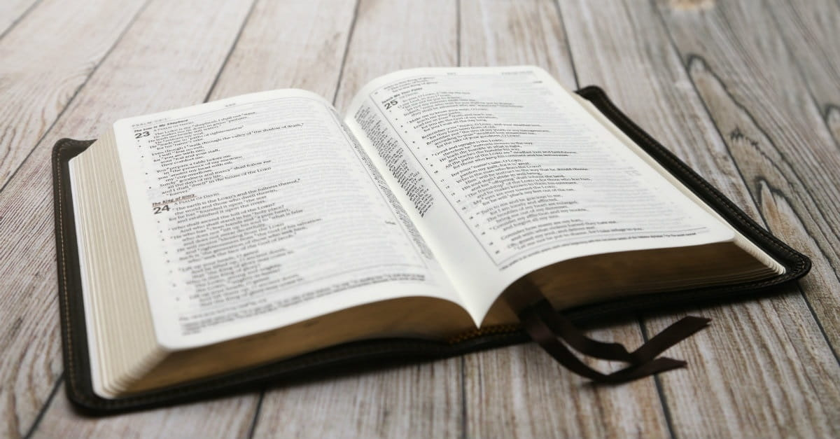
本月金句
詩篇
145:8-9 (Psalms)

Slide 36
145:8 耶和華有恩惠，有憐憫，不輕易發怒，大有慈愛。
145:9 耶和華善待萬民；他的慈悲覆庇他一切所造的。
本月金句 Monthly Verse
詩篇 145:8-9 (Psalms)

Slide 37
145:8 The Lord is gracious, kind and tender. He is slow to get angry and full of love.
145:9 The Lord is good to all. He shows deep concern for everything he has made.
本月金句 Monthly Verse
詩篇 145:8-9 (Psalms)

Slide 38
讀經
士師記
3:12-31 (Judges)

Slide 39
3:12 以色列人又行耶和華
眼中看為惡的事，耶和
華就使摩押王伊磯倫強盛，攻擊以色列人。 3:13 伊磯倫招聚亞捫人和亞瑪力人，去攻打以色列人，佔據棕樹城。
士師記 3:12-31 (Judges)

Slide 40
3:14 於是以色列人服事
摩押王伊磯倫十八年。
士師記 3:12-31 (Judges)

Slide 41
3:15 以色列人呼求耶和華
的時候，耶和華就為他們
興起一位拯救者，就是便雅憫人基拉的兒子以笏，他是左手便利的。以色列人託他送禮物給摩押王伊磯倫。
士師記 3:12-31 (Judges)

Slide 42
3:16 以笏打了一把兩刃的劍，
長一肘，帶在右腿上衣服裡
面。3:17 他將禮物獻給摩押王伊磯倫 (原來伊磯倫極其肥胖)。 3:18 以笏獻完禮物，便將抬禮物的人打發走了，
士師記 3:12-31 (Judges)

Slide 43
3:19 自己卻從靠近吉甲鑿石
之地回來，說：「王啊，
我有一件機密事奏告你。」王說：「迴避罷！」於是左右侍立的人都退去了。
士師記 3:12-31 (Judges)

Slide 44
3:20 以笏來到王面前。王獨
自一人坐在涼樓上。以笏
說：「我奉神的命報告你一件事。」王就從座位上站起來。3:21 以笏便伸左手，從右腿上拔出劍來，刺入王的肚腹，
士師記 3:12-31 (Judges)

Slide 45
3:22 連劍把都刺進去了。劍
被肥肉夾住，他沒有從王的
肚腹拔出來，且穿通了後身。3:23 以笏就出到遊廊，將樓門盡都關鎖。
士師記 3:12-31 (Judges)

Slide 46
3:24 以笏出來之後，王的僕
人到了，看見樓門關鎖，就
說：「他必是在樓上大解。」
3:25 他們等煩了，見仍不開樓門，就拿鑰匙開了。不料，他們的主人已死，倒在地上。
士師記 3:12-31 (Judges)

Slide 47
3:26 他們耽延的時候，以笏
就逃跑了，經過鑿石之地，
逃到西伊拉， 3:27 到了，就在以法蓮山地吹角。以色列人隨著他下了山地，他在前頭引路，
士師記 3:12-31 (Judges)

Slide 48
3:28 對他們說：「你們隨我
來，因為耶和華已經把你
們的仇敵摩押人交在你們手中。」於是他們跟著他下去，把守約但河的渡口，不容摩押一人過去。
士師記 3:12-31 (Judges)

Slide 49
3:29 那時擊殺了摩押人約有
一萬，都是強壯的勇士，
沒有一人逃脫。3:30 這樣，摩押就被以色列人制伏了。國中太平八十年。
士師記 3:12-31 (Judges)

Slide 50
3:31 以笏之後，有亞拿的兒
子珊迦，他用趕牛的棍子打
死六百非利士人。他也救了以色列人。
士師記 3:12-31 (Judges)

Slide 51
信息 張家群牧師
以笏: 用左手的士師!

Slide 52

奉獻
  Hymns of Life
  生命聖詩 469 首
為耶穌而活

Slide 53
為耶穌而活，是生命真義，
思想或言行，滿足主心意，
欣然順服主，憑主旨引領，
這樣為主活，是蒙福路程。
Living for Jesus a life that is true
Striving to please Him in all that I do
Yielding allegiance, glad hearted and free
This is the pathway of blessing for me
為耶穌而活 Living for Jesus
Hymns of Life 生命聖詩 469 首
V1

Slide 54
基督耶穌我救主，
我獻身心給祢；
因祢在十字架上，
甘願為我捨己；
O Jesus, Lord and Saviour
I give myself to Thee
For Thou, in Thy atonement
Didst give Thyself for me
為耶穌而活 Living for Jesus
Hymns of Life 生命聖詩 469 首
Ca

Slide 55
祢是我唯一主宰，
我心作祢寶座，
從此我要為主而活，
主啊，專一為祢。
I own no other Master
My heart shall be Thy throne
My life I give, henceforth to live
O Christ, for Thee alone
為耶穌而活 Living for Jesus
Hymns of Life 生命聖詩 469 首
Cb

Slide 56
為耶穌而活，祂為我受死，
背負我罪債，受凌辱唾棄，
如此大慈愛，感動我歸依，
我願獻一切，跟隨主到底。
Living for Jesus who died in my place
Bearing on Calv’ry my sin and disgrace
Such love constrains me to answer His call
Follow His leading and give Him my all
為耶穌而活 Living for Jesus
Hymns of Life 生命聖詩 469 首
V2

Slide 57
基督耶穌我救主，
我獻身心給祢；
因祢在十字架上，
甘願為我捨己；
O Jesus, Lord and Saviour
I give myself to Thee
For Thou, in Thy atonement
Didst give Thyself for me
為耶穌而活 Living for Jesus
Hymns of Life 生命聖詩 469 首
Ca

Slide 58
祢是我唯一主宰，
我心作祢寶座，
從此我要為主而活，
主啊，專一為祢。
I own no other Master
My heart shall be Thy throne
My life I give, henceforth to live
O Christ, for Thee alone
為耶穌而活 Living for Jesus
Hymns of Life 生命聖詩 469 首
Cb

Slide 59
為耶穌而活，在短暫世間，
我心最寶貴主慈愛笑容，
深願為我主，去尋找迷羊，
帶領疲倦者，安息主懷中。
Living for Jesus thro’ earth’s little while
My dearest treasure, the light of His smile
Seeking the lost ones He died to redeem
Bringing the weary to find rest in Him
為耶穌而活 Living for Jesus
Hymns of Life 生命聖詩 469 首
V3

Slide 60
基督耶穌我救主，
我獻身心給祢；
因祢在十字架上，
甘願為我捨己；
O Jesus, Lord and Saviour
I give myself to Thee
For Thou, in Thy atonement
Didst give Thyself for me
為耶穌而活 Living for Jesus
Hymns of Life 生命聖詩 469 首
Ca

Slide 61
祢是我唯一主宰，
我心作祢寶座，
從此我要為主而活，
主啊，專一為祢。
I own no other Master
My heart shall be Thy throne
My life I give, henceforth to live
O Christ, for Thee alone
為耶穌而活 Living for Jesus
Hymns of Life 生命聖詩 469 首
Cb

Slide 62
W e l c o m e
歡迎新來賓

Slide 63
報告

Slide 64

回應詩
  Hymns of Life
  生命聖詩 374 首
更像我恩主

Slide 65
更像我恩主，時刻像我主，
更有祂溫柔，更謙和忠恕，
更熱心工作，更加勇敢忠誠；
更樂意奉獻，完成恩主使命。
More like the Master I would ever be
More of His meekness more humility
More zeal to labour, more courage to be true
More consecration for work He bids me do
更像我恩主 More Like the Master
Hymns of Life 生命聖詩 374 首
V1

Slide 66
求主悅納，我心單獨屬祢；
求主悅納，我心完全屬祢；
懇求恩主，洗除我眾愆尤，
潔淨保守我，永屬祢所有。
Take Thou my heart, I would be Thine alone
Take Thou my heart and make it all Thine own
Purge me from sin, O Lord, I now implore
Wash me and keep me Thine forever more
更像我恩主 More Like the Master
Hymns of Life 生命聖詩 374 首
C

Slide 67
更像我恩主，我每日祈求，
更多有力量，背我十架走，
更盡心盡力，使主國早降臨；
更充滿靈力，去尋找失喪人。
More like the Master is my daily prayer
More strength to carry crosses I must bear
More earnest effort to bring His Kingdom in
More of His Spirit, the wanderer to win
更像我恩主 More Like the Master
Hymns of Life 生命聖詩 374 首
V2

Slide 68
求主悅納，我心單獨屬祢；
求主悅納，我心完全屬祢；
懇求恩主，洗除我眾愆尤，
潔淨保守我，永屬祢所有。
Take Thou my heart, I would be Thine alone
Take Thou my heart and make it all Thine own
Purge me from sin, O Lord, I now implore
Wash me and keep me Thine forever more
更像我恩主 More Like the Master
Hymns of Life 生命聖詩 374 首
C

Slide 69
更像我恩主，靈命日增長，
更充滿主愛，在人前表揚；
更願意捨己，像主客園祈禱；
更像我恩主，直到永永遠遠。
More like the Master I would live and grow
More of His love to others I would show
More self-denial, like His in Galilee
More like the Master I long to ever be
更像我恩主 More Like the Master
Hymns of Life 生命聖詩 374 首
V3

Slide 70
求主悅納，我心單獨屬祢；
求主悅納，我心完全屬祢；
懇求恩主，洗除我眾愆尤，
潔淨保守我，永屬祢所有。
Take Thou my heart, I would be Thine alone
Take Thou my heart and make it all Thine own
Purge me from sin, O Lord, I now implore
Wash me and keep me Thine forever more
更像我恩主 More Like the Master
Hymns of Life 生命聖詩 374 首
C

Slide 71
祝 福

Slide 72
默禱．散會

